Slide 1

Proposal for School Bus Solution
Jan 2019

Slide 2

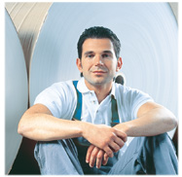
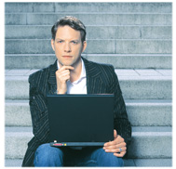

About SPL - Company vision is to be the best retail IT service provider
SPL Information Technology is an IT service provider established by SPL HK in mainland China in 2005.
Focus on & Retail App & infrastructure services
With 400+ professionals
Serves 30+ retail customers
Operates 70+ service stations in tier 1,2,3 & 4 cities in China and some countries/regions in APAC
- Confidential -

Slide 3



















Company development - Wider coverage, increasing clients and diverse business range
New coverage
App Development
Help Desk
Dispatch
ITO
Project Rollout
Store Network
Data Center
NOC
Private & Hybrid clouds
New client
New business
- Confidential -

Slide 4
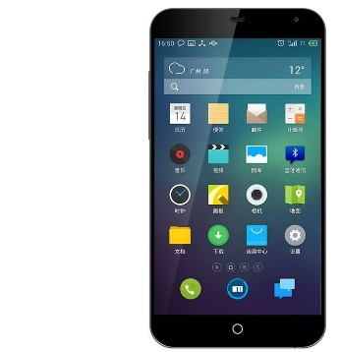



Solution introduction - Architecture
App installed on parent's mobile phone
App installed on shuttle staff’
s mobile phone
Management console in the school
Backend system and database on the cloud
- Confidential -

Slide 5
Solution introduction - Function module for parent
Other function
Complains submission
Survey
Attendance
Arrival
Sign-off
Arrival notification
Registration
Application for absence
New pick-up site application
Departure
Journey
Onboard Sign-on
Departure notification
Live broadcast on parents’ App
Real-time position of shuttle bus
Estimated arrival time for pick-up
Emergency broadcast
Communication with Shuttle bus staff
- Confidential -

Slide 6
Solution introduction - Function module for school & shuttle bus staff
1
Automatic roll call via onboard record
Vehicle management, i.e. condition, maintenance information, etc.
2
3
Driver management, i.e. license, personal information, etc.
Interface with government platform, i.e. route design, application, optimization, etc.
4
- Confidential -

Slide 7
Charge model & SLA - Software as A Service
No one time cost i.e. hardware, license, development and the ongoing expenses.
Service fee will be charged based on the App amount installed by parents.
Service Level Agreement will be defined together with school.
- Confidential -

Slide 8

Thank you!
SPL Information Technology

